Slide 1
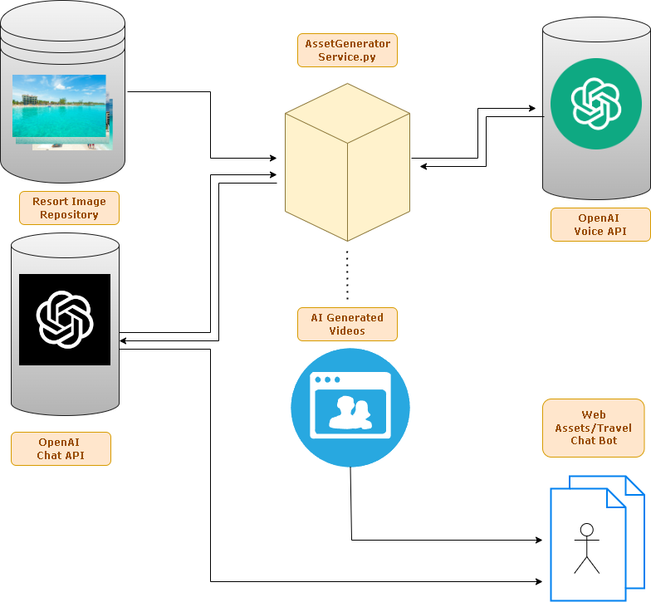
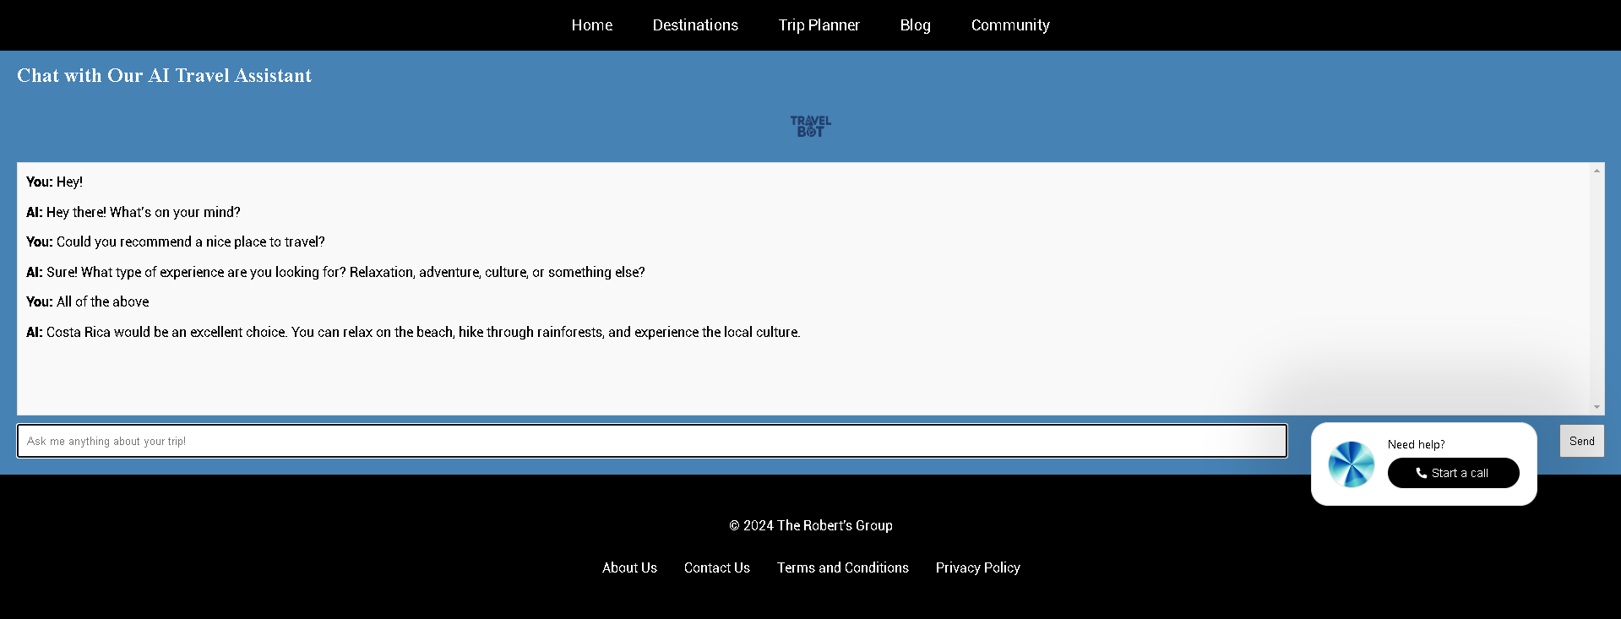
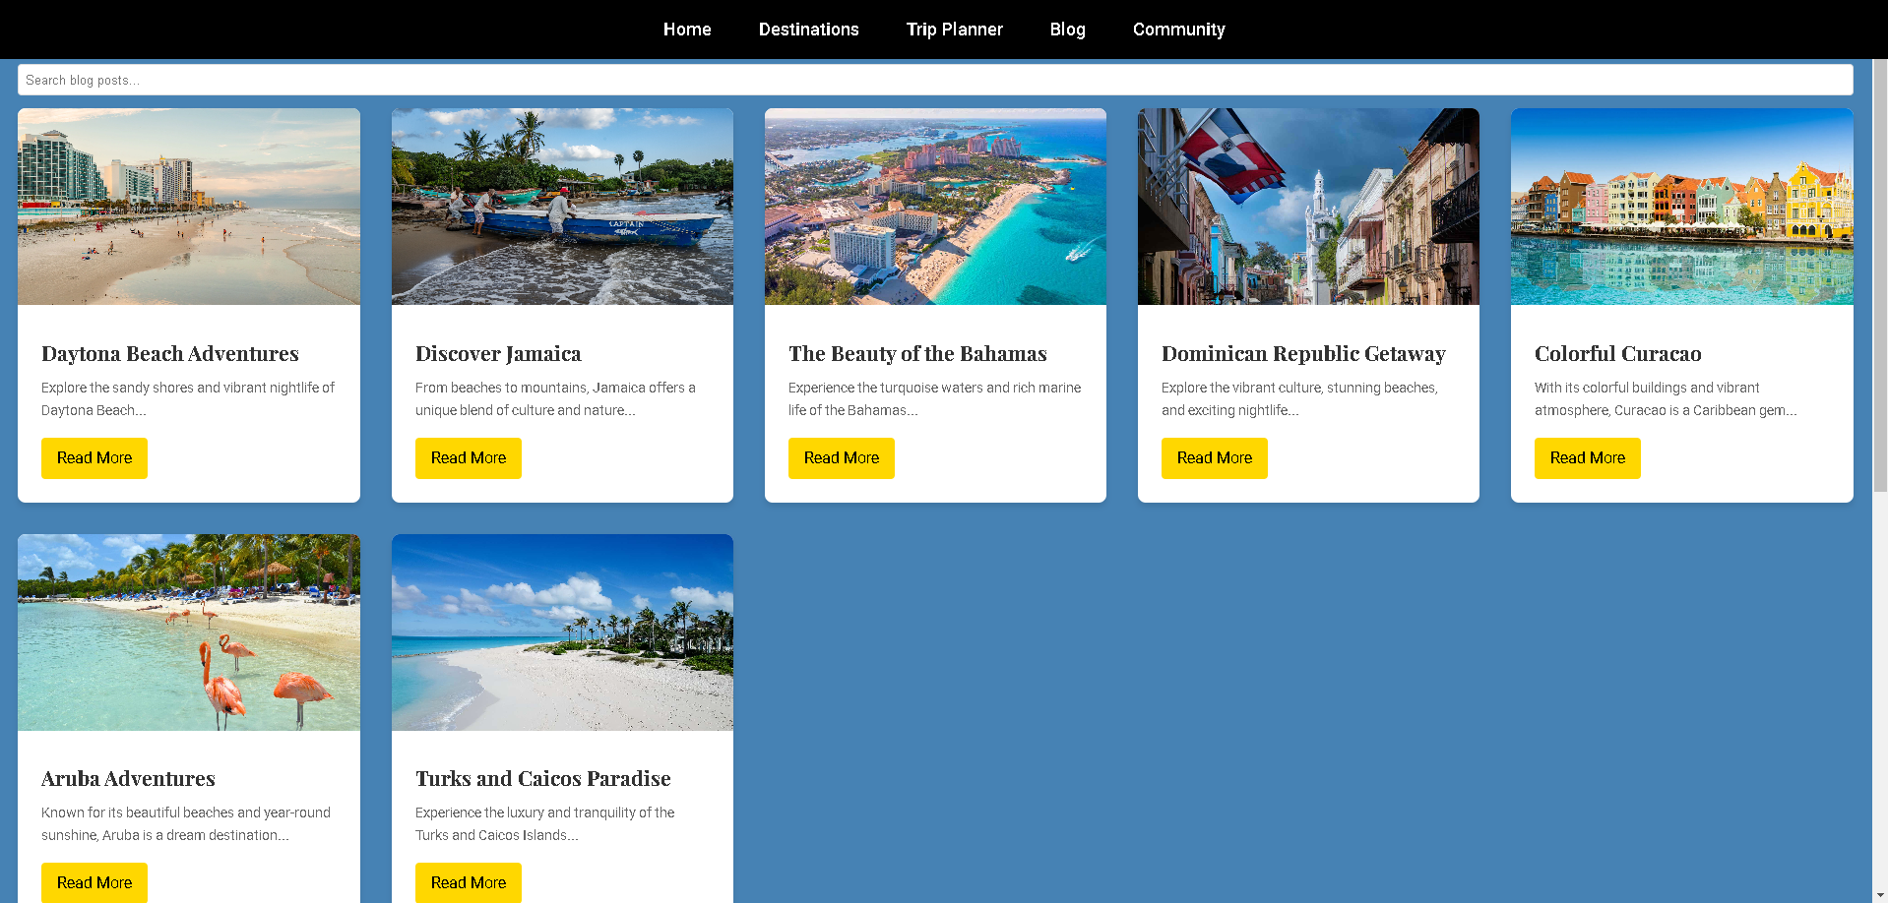


25-335
Streamline process for using AI powered projects to help digital marketers save time
in the content creation process
Team members: Marcio Tejeda, David Newman, Ethan DuBrueler, and Noah Davis | Faculty adviser: Caroline Budwell, Ph.D. | Sponsor: Amanda Roberts (The Roberts Group)
Problem Statement
The digital marketing space, particularly within the travel industry, faces a significant challenge in providing personalized, engaging content to potential travelers while efficiently managing the booking process. Travel marketers often face the burden of creating dynamic content, curating personalized recommendations, and streamlining processes–all of which are time-consuming and labor-intensive.
Solution
This project aims to develop an AI platform for digital marketers in the travel industry that aids with content generation and expedites the process of destination travel booking for their clients. The key features include:
A chatbot that helps travelers select their ideal hotel based on preferences like location, budget, and desired experience
AI-generated videos showcasing the users' desired destinations
Hotel recommendations based on user input

